Slide 1
Agile Development
Businesses now operate in a global, rapidly changing environment.
They have to respond to new opportunities and markets, changing economic conditions and the emergence of competing products and services.
Software is part of almost all business operations, so new software has to be developed quickly to take advantage of new opportunities and to respond to competitive pressure.
Rapid software development and delivery is therefore the most critical requirement for most business systems.
In fact, businesses may be willing to trade off software quality and compromise on requirements if they can deploy essential new software quickly.
Because these businesses are operating in a changing environment, it is practically impossible to derive a complete set of stable software requirements.
Requirements change because customers find it impossible to predict how a system will affect working practices, how it will interact with other systems, and what user operations should be automated.

Slide 2
Agile Development
It may only be after a system has been delivered and users gain experience with it that the real requirements become clear. Even then, external factors drive requirements change.
Plan-driven software development processes that completely specify the requirements and then design, build, and test a system are not geared to rapid software development.
As the requirements change or as requirements problems are discovered, the system design or implementation has to be reworked and retested.
As a consequence, a conventional waterfall or specification-based process is usually a lengthy one, and the final software is delivered to the customer long after it was originally specified.
For some types of software, such as safety-critical control systems, where a complete analysis of the system is essential, this plan-driven approach is the right one.
However, in a fast-moving business environment, it can cause real problems.
By the time the software is available for use, the original reason for its procurement may have changed so radically that the software is effectively useless.
Therefore, for business systems in particular, development processes that focus on rapid software development and delivery are essential.

Slide 3
Agile Development
The need for rapid software development and processes that can handle changing requirements has been recognized for many years.
However, faster software development really took off in the late 1990s with the development of the idea of “agile methods” such as Extreme Programming, Scrum, and DSDM(Dynamic System Development Method).
Rapid software development became known as agile development or agile methods.
These agile methods are designed to produce useful software quickly.
All of the agile methods that have been proposed share a number of common characteristics:
1. The processes of specification, design and implementation are interleaved. There is no detailed system specification, and design documentation is minimized or generated automatically by the programming environment used to implement the system. The user requirements document is an outline definition of the most important characteristics of the system.
2. The system is developed in a series of increments. End-users and other system stakeholders are involved in specifying and evaluating each increment. They may propose changes to the software and new requirements that should be implemented in a later version of the system.
3. Extensive tool support is used to support the development process. Tools that may be used include automated testing tools, tools to support configuration management, and system integration and tools to automate user interface production.

Slide 4
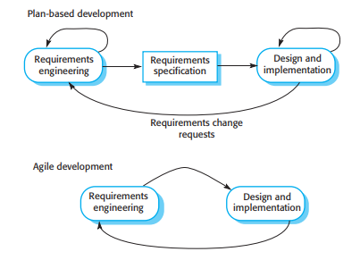
Plan-Driven vs. Agile Development
Fig: Plan driven and agile development:

Slide 5
Plan-Driven vs. Agile Development
Agile methods are incremental development methods in which the increments are small, and, typically, new releases of the system are created and made available to customers every two or three weeks.
They involve customers in the development process to get rapid feedback on changing requirements.
They minimize documentation by using informal communications rather than formal meetings with written documents.
Agile approaches to software development consider design and implementation to be the central activities in the software process.
They incorporate other activities, such as requirements elicitation and testing, into design and implementation.
By contrast, a plan-driven approach to software engineering identifies separate stages in the software process with outputs associated with each stage.
The outputs from one stage are used as a basis for planning the following process activity.

Slide 6
Plan-Driven vs. Agile Development
Figure in above slide shows the essential distinctions between plan-driven and agile approaches to system specification.
In a plan-driven software development process, iteration occurs within activities, with formal documents used to communicate between stages of the process.
For example, the requirements will evolve, and, ultimately, a requirements specification will be produced.
This is then an input to the design and implementation process. In an agile approach, iteration occurs across activities. Therefore, the requirements and the design are developed together rather than separately.
In practice, plan-driven processes are often used along with agile programming practices, and agile methods may incorporate some planned activities apart from programming and testing.
It is perfectly feasible, in a plan-driven process, to allocate requirements and plan the design and development phase as a series of increments.
An agile process is not inevitably code-focused, and it may produce some design documentation.
Agile developers may decide that an iteration should not produce new code but rather should produce system models and documentation.

Slide 7
Agile Methods
In the 1980s and early 1990s, there was a widespread view that the best way to achieve better software was through careful project planning, formalized quality assurance, use of analysis and design methods supported by software tools, and controlled and rigorous software development processes.
This view came from the software engineering community that was responsible for developing large, long-lived software systems such as aerospace and government systems.
This plan-driven approach was developed for software developed by large teams, working for different companies.
Teams were often geographically dispersed and worked on the software for long periods of time.
An example of this type of software is the control systems for a modern aircraft, which might take up to 10 years from initial specification to deployment.
Plan-driven approaches involve a significant overhead in planning, designing, and documenting the system.
This overhead is justified when the work of multiple development teams has to be coordinated, when the system is a critical system, and when many different people will be involved in maintaining the software over its lifetime.

Slide 8
Agile Methods
However, when this heavyweight, plan-driven development approach is applied to small and medium-sized business systems, the overhead involved is so large that it dominates the software development process.
More time is spent on how the system should be developed than on program development and testing.
As the system requirements change, rework is essential and, in principle at least, the specification and design have to change with the program.
Dissatisfaction with these heavyweight approaches to software engineering led to the development of agile methods in the late 1990s.
These methods allowed the development team to focus on the software itself rather than on its design and documentation.
They are best suited to application development where the system requirements usually change rapidly during the development process.
They are intended to deliver working software quickly to customers, who can then propose new and changed requirements to be included in later iterations of the system.
They aim to cut down on process bureaucracy by avoiding work that has dubious long-term value and eliminating documentation that will probably never be used.

Slide 9
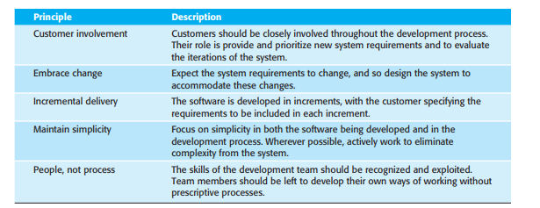
Agile Methods
Fig: The principles of agile methods

Slide 10
Agile Methods
All agile methods suggest that software should be developed and delivered incrementally.
These methods are based on different agile processes but they share a set of principles, based on the agile manifesto, and so they have much in common.
Agile methods have been particularly successful for two kinds of system development.
1. Product development where a software company is developing a small or medium-sized product for sale. Virtually all software products and apps are now developed using an agile approach.
2. Custom system development within an organization, where there is a clear commitment from the customer to become involved in the development process and where there are few external stakeholders and regulations that affect the software.
Agile methods work well in these situations because it is possible to have continuous communications between the product manager or system customer and the development team.
The software itself is a stand-alone system rather than tightly integrated with other systems being developed at the same time.
Consequently, there is no need to coordinate parallel development streams. Small and medium-sized systems can be developed by co-located teams, so informal communications among team members work well.

Slide 11
Agile development techniques
The ideas underlying agile methods were developed around the same time by a number of different people in the 1990s.
However, perhaps the most significant approach to changing software development culture was the development of Extreme Programming (XP).
The name was coined by Kent Beck (Beck 1998) because the approach was developed by pushing recognized good practice, such as iterative development, to “extreme” levels.
For example, in XP, several new versions of a system may be developed by different programmers, integrated, and tested in a day.
Figure below illustrates the XP process to produce an increment of the system that is being developed.
In XP, requirements are expressed as scenarios (called user stories), which are implemented directly as a series of tasks.
Programmers work in pairs and develop tests for each task before writing the code.
All tests must be successfully executed when new code is integrated into the system.
There is a short time gap between releases of the system.

Slide 12
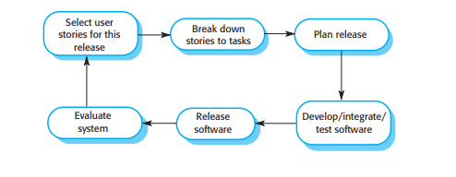
Agile development techniques
Fig: The XP release cycle

Slide 13
Agile development techniques
Extreme programming was controversial as it introduced a number of agile practices that were quite different from the development practice of that time. These practices are summarized in Figure below and reflect the principles of the agile manifesto:
1. Incremental development is supported through small, frequent releases of the system. Requirements are based on simple customer stories or scenarios that are used as a basis for deciding what functionality should be included in a system increment.
2. Customer involvement is supported through the continuous engagement of the customer in the development team. The customer representative takes part in the development and is responsible for defining acceptance tests for the system.
3. People, not process, are supported through pair programming, collective ownership of the system code, and a sustainable development process that does not involve excessively long working hours.
4. Change is embraced through regular system releases to customers, test-first development, refactoring to avoid code degeneration, and continuous integration of new functionality.
5. Maintaining simplicity is supported by constant refactoring that improves code quality and by using simple designs that do not unnecessarily anticipate future changes to the system.

Slide 14
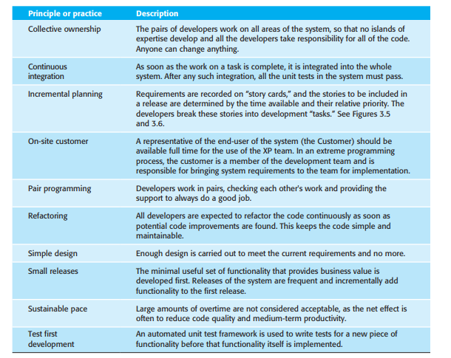
Agile development techniques
Figure: Extreme programming practices

Slide 15
Agile development techniques
In practice, the application of Extreme Programming as originally proposed has proved to be more difficult than anticipated.
It cannot be readily integrated with the management practices and culture of most businesses.
Therefore, companies adopting agile methods pick and choose those XP practices that are most appropriate for their way of working.
Sometimes these are incorporated into their own development processes but, more commonly, they are used in conjunction with a management focused agile method such as Scrum.

Slide 16
User stories
Software requirements always change. To handle these changes, agile methods do not have a separate requirements engineering activity.
Rather, they integrate requirements elicitation with development.
To make this easier, the idea of “user stories” was developed where a user story is a scenario of use that might be experienced by a system user.
As far as possible, the system customer works closely with the development team and discusses these scenarios with other team members.
Together, they develop a “story card” that briefly describes a story that encapsulates the customer needs.
The development team then aims to implement that scenario in a future release of the software.
An example of a story card for the Mentcare system is shown in Figure in below slide. This is a short description of a scenario for prescribing medication for a patient.

Slide 17
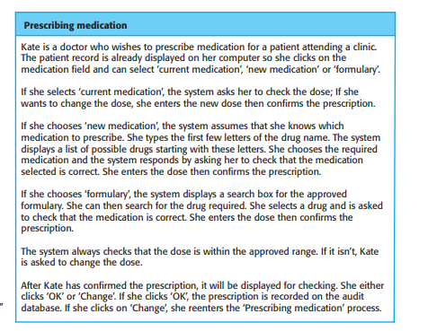
User stories
Fig: prescribing medication story

Slide 18
User stories
User stories may be used in planning system iterations.
Once the story cards have been developed, the development team breaks these down into tasks and estimates the effort and resources required for implementing each task.
This usually involves discussions with the customer to refine the requirements.
The customer then prioritizes the stories for implementation, choosing those stories that can be
used immediately to deliver useful business support.
The intention is to identify useful functionality that can be implemented in about two weeks, when the next release of the system is made available to the customer.
Of course, as requirements change, the unimplemented stories change or may be discarded.
If changes are required for a system that has already been delivered, new story cards are developed and again, the customer decides whether these changes should have priority over new functionality.

Slide 19
User stories
The idea of user stories is a powerful one—people find it much easier to relate to these stories than to a conventional requirements document or use cases.
User stories can be helpful in getting users involved in suggesting requirements during an initial predevelopment requirements elicitation activity.
The principal problem with user stories is completeness.
It is difficult to judge if enough user stories have been developed to cover all of the essential requirements of a system.
It is also difficult to judge if a single story gives a true picture of an activity.
Experienced users are often so familiar with their work that they leave things out when describing it.

Slide 20
Refactoring
A fundamental precept of traditional software engineering is that you should design for change.
That is, you should anticipate future changes to the software and design it so that these changes can be easily implemented.
Extreme programming, however, has discarded this principle on the basis that designing for change is often wasted effort.
It isn’t worth taking time to add generality to a program to cope with change.
Often the changes anticipated never materialize, or completely different change requests may actually be made.
Of course, in practice, changes will always have to be made to the code being developed.
To make these changes easier, the developers of XP suggested that the code being developed should be constantly refactored.
Refactoring means that the programming team look for possible improvements to the software and implements them immediately.
When team members see code that can be improved, they make these improvements even in situations where there is no immediate need for them.

Slide 21
Refactoring
A fundamental problem of incremental development is that local changes tend to degrade the software structure.
Consequently, further changes to the software become harder and harder to implement.
Essentially, the development proceeds by finding workarounds to problems, with the result that code is often duplicated, parts of the software are reused in inappropriate ways, and the overall structure degrades as code is added to the system.
Refactoring improves the software structure and readability and so avoids the structural deterioration that naturally occurs when software is changed.
Examples of refactoring include the reorganization of a class hierarchy to remove duplicate code, the tidying up and renaming of attributes and methods, and the replacement of similar code sections, with calls to methods defined in a program library.
Program development environments usually include tools for refactoring.
These simplify the process of finding dependencies between code sections and making global code modifications.

Slide 22
Refactoring
In principle, when refactoring is part of the development process, the software should always be easy to understand and change as new requirements are proposed.
In practice, this is not always the case. Sometimes development pressure means that refactoring is delayed because the time is devoted to the implementation of new functionality.
Some new features and changes cannot readily be accommodated by code-level refactoring and require that the architecture of the system be modified.

Slide 23
Test-first development
As discussed in the introduction to this chapter, one of the important differences between incremental development and plan-driven development is in the way that the system is tested.
With incremental development, there is no system specification that can be used by an external testing team to develop system tests.
As a consequence, some approaches to incremental development have a very informal testing process, in comparison with plan-driven testing.
Extreme Programming developed a new approach to program testing to address the difficulties of testing without a specification.
Testing is automated and is central to the development process, and development cannot proceed until all tests have been successfully executed.
The key features of testing in XP are:
1. test-first development,
2. incremental test development from scenarios,
3. user involvement in the test development and validation, and
4. the use of automated testing frameworks.

Slide 24
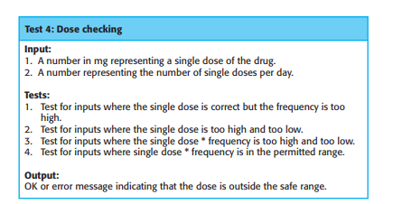
Test-first development
XP’s test-first philosophy has now evolved into more general test-driven development techniques.
Test-driven development is one of the most important innovations in software engineering.
Instead of writing code and then writing tests for that code, you write the tests before you write the code.
This means that you can run the test as the code is being written and discover problems during development.
Fig: Test case description for
dose checking

Slide 25
Test-first development
Writing tests implicitly defines both an interface and a specification of behavior for the functionality being developed.
Problems of requirements and interface misunderstandings are reduced.
Test-first development requires there to be a clear relationship between system requirements and the code implementing the corresponding requirements.
In XP, this relationship is clear because the story cards representing the requirements are broken down into tasks and the tasks are the principal unit of implementation.
In test-first development, the task implementers have to thoroughly understand the specification so that they can write tests for the system.
This means that ambiguities and omissions in the specification have to be clarified before implementation begins.
Furthermore, it also avoids the problem of “test-lag.” This may happen when the developer of the system works at a faster pace than the tester.
The implementation gets further and further ahead of the testing and there is a tendency to skip tests, so that the development schedule can be maintained.

Slide 26
Test-first development
XP’s test-first approach assumes that user stories have been developed, and these have been broken down into a set of task cards.
Each task generates one or more unit tests that check the implementation described in that task.
Figure in above slide is a shortened description of a test case that has been developed to check that the prescribed dose of a drug does not fall outside known safe limits.
The role of the customer in the testing process is to help develop acceptance tests for the stories that are to be implemented in the next release of the system.
Test automation is essential for test-first development.
Tests are written as executable components before the task is implemented.
These testing components should be stand-alone, should simulate the submission of input to be tested, and should check that the result meets the output specification.
An automated test framework is a system that makes it easy to write executable tests and submit a set of tests for execution.

Slide 27
Test-first development
As testing is automated, there is always a set of tests that can be quickly and easily executed.
Whenever any functionality is added to the system, the tests can be run and problems that the new code has introduced can be caught immediately.
Test-first development and automated testing usually result in a large number of tests being written and executed.
However, there are problems in ensuring that test coverage is complete:
1. Programmers prefer programming to testing, and sometimes they take shortcuts when writing tests. For example, they may write incomplete tests that do not check for all possible exceptions that may occur.
2. Some tests can be very difficult to write incrementally. For example, in a complex user interface, it is often difficult to write unit tests for the code that implements the “display logic” and workflow between screens.
It is difficult to judge the completeness of a set of tests. Although you may have a lot of system tests, your test set may not provide complete coverage.
Crucial parts of the system may not be executed and so will remain untested.
Therefore, although a large set of frequently executed tests may give the impression that the system is complete and correct, this may not be the case.
If the tests are not reviewed and further tests are written after development, then undetected bugs may be delivered in the system release.

Slide 28
Pair programming
Another innovative practice that was introduced in XP is that programmers work in pairs to develop the software.
The programming pair sits at the same computer to develop the software.
However, the same pair do not always program together.
Rather, pairs are created dynamically so that all team members work with each other during the development process.
Pair programming has a number of advantages.
1. It supports the idea of collective ownership and responsibility for the system. This reflects Weinberg’s idea of egoless programming (Weinberg 1971) where the software is owned by the team as a whole and individuals are not held responsible for problems with the code. Instead, the team has collective responsibility for resolving these problems.
2. It acts as an informal review process because each line of code is looked at by at least two people. Code inspections and reviews are effective in discovering a high percentage of software errors. However, they are time consuming to organize and, typically, introduce delays into the development process. Pair programming is a less formal process that probably doesn’t find as many errors as code inspections. However, it is cheaper and easier to organize than formal program inspections.

Slide 29
Pair programming
3. It encourages refactoring to improve the software structure. The problem with asking programmers to refactor in a normal development environment is that effort involved is expended for long-term benefit. An developer who spends time refactoring may be judged to be less efficient than one who simply carries on developing code. Where pair programming and collective ownership are used, others benefit immediately from the refactoring so they are likely to support the process.
You might think that pair programming would be less efficient than individual programming.
In a given time, a pair of developers would produce half as much code as two individuals working alone.
Many companies that have adopted agile methods are suspicious of pair programming and do not use it.
Other companies mix pair and individual programming with an experienced programmer working with a less experienced colleague when they have problems.

Slide 30
Pair programming
Formal studies of the value of pair programming have had mixed results.
Using student volunteers, Williams and her collaborators found that productivity with pair programming seems to be comparable to that of two people working independently.
The reasons suggested are that pairs discuss the software before development and so probably have fewer false starts and less rework.
Furthermore, the number of errors avoided by the informal inspection is such that less time is spent repairing bugs discovered during the testing process.
However, studies with more experienced programmers did not replicate these.
They found that there was a significant loss of productivity compared with two programmers working alone.
There were some quality benefits, but these did not fully compensate for the pair-programming overhead.
Nevertheless, the sharing of knowledge that happens during pair programming is very important as it reduces the overall risks to a project when team members leave.
In itself, this may make pair programming worthwhile.

Slide 31
Agile project management
In any software business, managers need to know what is going on and whether or not a project is likely to meet its objectives and deliver the software on time with the proposed budget.
Plan-driven approaches to software development evolved to meet this need. As discussed , managers draw up a plan for the project showing what should be delivered, when it should be delivered, and who will work on the development of the project deliverables.
A plan-based approach requires a manager to have a stable view of everything that has to be developed and the development processes.
The informal planning and project control that was proposed by the early adherents of agile methods clashed with this business requirement for visibility.
Teams were self-organizing, did not produce documentation, and planned development in very short cycles.
While this can and does work for small companies developing software products, it is inappropriate for larger companies who need to know what is going on in their organization.

Slide 32
Agile project management
Like every other professional software development process, agile development has to be managed so that the best use is made of the time and resources available to the team.
To address this issue, the Scrum agile method was to provide a framework for organizing agile projects and, to some extent at least, provide external visibility of what is going on.
The developers of Scrum wished to make clear that Scrum was not a method for project management in the conventional sense, so they deliberately invented new terminology, such as ScrumMaster, which replaced names such as project manager.
Scrum is an agile method insofar as it follows the principles from the agile manifesto.
However, it focuses on providing a framework for agile project organization, and it does not mandate the use of specific development practices such as pair programming and test-first development.
This means that it can be more easily integrated with existing practice in a company.
Consequently, as agile methods have become a mainstream approach to software development, Scrum has emerged as the most widely used method.

Slide 33
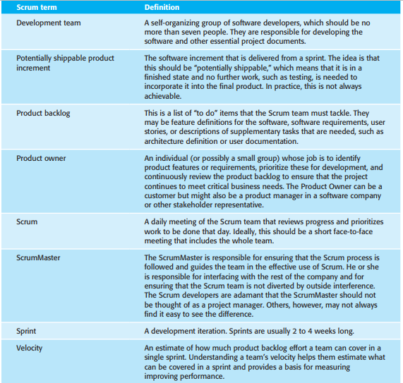
Agile project management
Fig: Scrum terminology

Slide 34
Agile project management
The Scrum process or sprint cycle is shown in Figure below.
The input to the process is the product backlog.
Each process iteration produces a product increment that could be delivered to customers.
The starting point for the Scrum sprint cycle is the product backlog—the list of items such as product features, requirements, and engineering improvement that have to be worked on by the Scrum team.
The initial version of the product backlog may be derived from a requirements document, a list of user stories, or other description of the software to be developed.
While the majority of entries in the product backlog are concerned with the implementation of system features, other activities may also be included.
Sometimes, when planning an iteration, questions that cannot be easily answered come to light and additional work is required to explore possible solutions.
The team may carry out some prototyping or trial development to understand the problem and solution.
There may also be backlog items to design the system architecture or to develop system documentation.

Slide 35
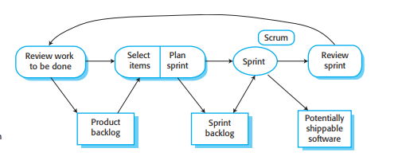
Agile project management
Figure: The Scrum software sprint cycle

Slide 36
Agile project management
The product backlog may be specified at varying levels of detail, and it is the responsibility of the Product Owner to ensure that the level of detail in the specification is appropriate for the work to be done.
For example, a backlog item could be a complete user story s, or it could simply be an instruction such as “Refactor user interface code” that leaves it up to the team to decide on the refactoring to be done.
Each sprint cycle lasts a fixed length of time, which is usually between 2 and 4 weeks.
At the beginning of each cycle, the Product Owner prioritizes the items on the product backlog to define which are the most important items to be developed in that cycle.
Sprints are never extended to take account of unfinished work.
Items are returned to the product backlog if these cannot be completed within the allocated time for the sprint.

Slide 37
Agile project management
The whole team is then involved in selecting which of the highest priority items they believe can be completed.
They then estimate the time required to complete these items.
To make these estimates, they use the velocity attained in previous sprints, that is, how much of the backlog could be covered in a single sprint.
This leads to the creation of a sprint backlog—the work to be done during that sprint.
The team self-organizes to decide who will work on what, and the sprint begins.
During the sprint, the team holds short daily meetings (Scrums) to review progress and, where necessary, to re-prioritize work.
During the Scrum, all team members share information, describe their progress since the last meeting, bring up problems that have arisen, and state what is planned for the following day.
Thus, everyone on the team knows what is going on and, if problems arise, can re-plan short-term work to cope with them.
Everyone participates in this short-term planning; there is no top-down direction from the ScrumMaster.

Slide 38
Agile project management
The daily interactions among Scrum teams may be coordinated using a Scrum board.
This is an office whiteboard that includes information and post-it notes about the Sprint backlog, work done, unavailability of staff, and so on.
This is a shared resource for the whole team, and anyone can change or move items on the board.
It means that any team member can, at a glance, see what others are doing and what work remains to be done.
At the end of each sprint, there is a review meeting, which involves the whole team.
This meeting has two purposes.
First, it is a means of process improvement.
The team reviews the way they have worked and reflects on how things could have been done better. Second, it provides input on the product and the product state for the product backlog review that precedes the next sprint.

Slide 39
Agile project management
While the ScrumMaster is not formally a project manager, in practice Scrum Masters take this role in many organizations that have a conventional management structure.
They report on progress to senior management and are involved in longer-term planning and project budgeting.
They may be involved in project administration (agreeing on holidays for staff, liaising with HR, etc.) and hardware and software purchases.
In various Scrum success stories the things that users like about the Scrum method are:
1. The product is broken down into a set of manageable and understandable chunks that stakeholders can relate to.
2. Unstable requirements do not hold up progress.
3. The whole team has visibility of everything, and consequently team communication and morale are improved.
4. Customers see on-time delivery of increments and gain feedback on how the product works They are not faced with last-minute surprises when a team announces that software will not be delivered as expected.
5. Trust between customers and developers is established, and a positive culture is created in which everyone expects the project to succeed.

Slide 40
Agile project management
Scrum, as originally designed, was intended for use with co-located teams where all team members could get together every day in stand-up meetings.
However, much software development now involves distributed teams, with team members located in different places around the world.
This allows companies to take advantage of lower cost staff in other countries, makes access to specialist skills possible, and allows for 24-hour development, with work going on in different time zones.
Consequently, there have been developments of Scrum for distributed development environments and multi-team working. Typically, for offshore development, the product owner is in a different country from the development team, which may also be distributed. Figure below shows the requirements for Distributed Scrum.

Slide 41
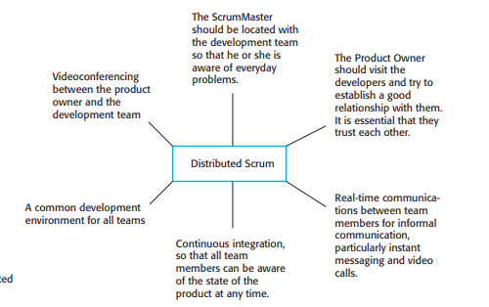
Agile project management
Fig: Distributed Scrum

